Slide 1
Remote Sensing Summer School 2013 Steve Ackerman (CIMSS)
Three different cloud scenes

Slide 2
Case 1

Slide 3
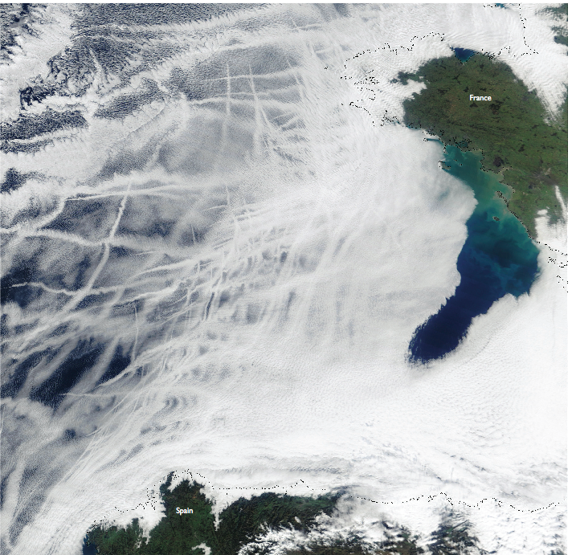
MODIS Terra True Color Imagery, 27 January 2003
Case on Image Library

Slide 4
Ship Tracks
Ship tracks are clouds that form in the exhaust of ships traveling below the clouds. The effluents from the engines seed cloud droplets. The ship tracks can stretch over a long narrow path, and the wind can advect them in the cloud field.
These features are evidence of the indirect effect of human made aerosols on climate.
When compared to natural cloud field, the number of water droplets per volume of air in ship tracks are more than doubled, the radius of the drops is decreased by roughly six percent and the total volume of liquid water per volume of air is increased twofold.

Slide 5
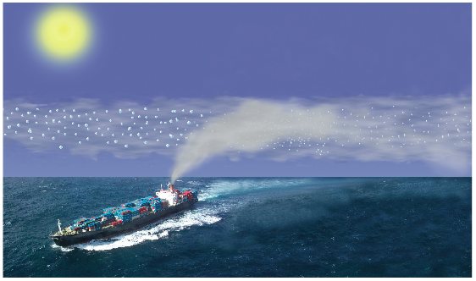
Ship Track Schematic
Smaller droplets in Polluted Cloud Can Lead to Brighter Clouds
Notes:
All slides from: “S. Platnick, 2006: Ship Tracks. Our Changing Planet, M. D. King, C. L. Parkinson, K. C. Partington, R. Williams, Eds., Cambridge University Press.”
… can lead to brighter clouds is LWP is not lost (does happen) and the same amount of water is distributed among more droplets (increases optical thickness).

Slide 6
MODIS Aqua True Color Image – bottom left section of previous image
Arrows show direction of the ship derived
From MODIS Terra Imagery (1 hr 40 min time difference)

Slide 7
MODIS Cloud Droplet Effective Radius Retrievals
Notes:
Retrievals for the true color region in the previous slide. Note smaller droplets in the tracks

Slide 8
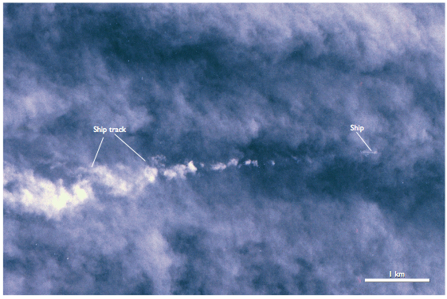
Ship Track Photograph During Monterey Area Ship Track Experiment (MAST)
From RC-10 camera on NASA ER-2, 13 June 1994
Notes:
Highest resolution photography (3-6 m resolution). Can just make out container sections on the deck of the freighter.

Slide 9
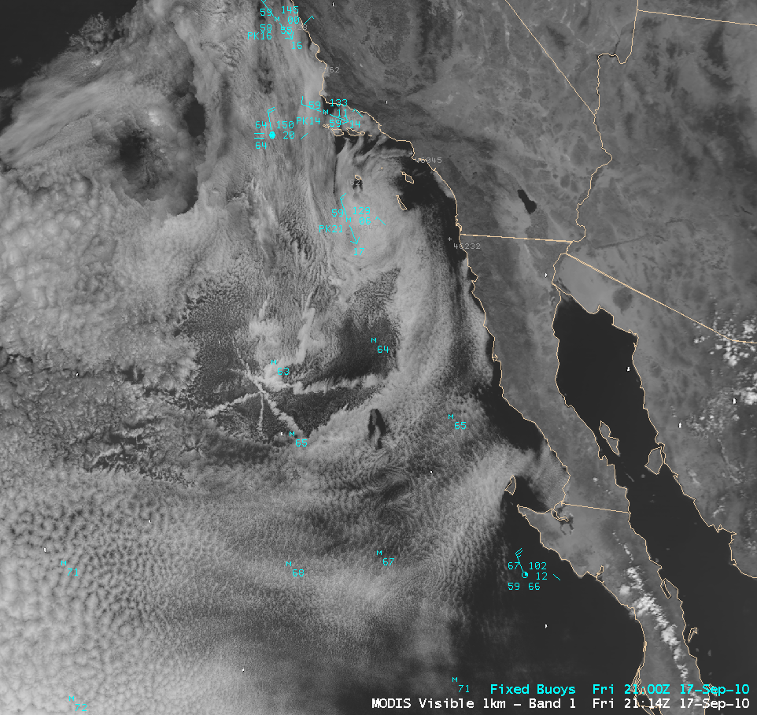

Slide 10
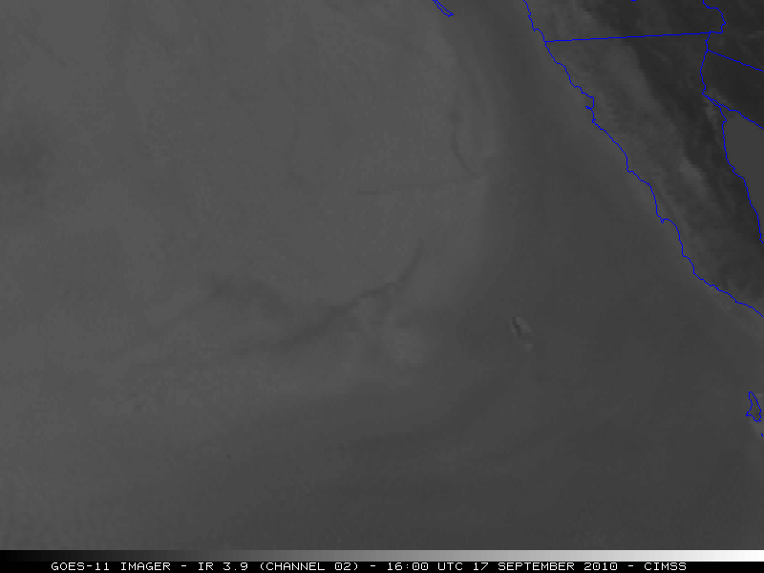
GOES-11 (US Geostationary satellite) animation of 3.7 micron channel

Slide 11
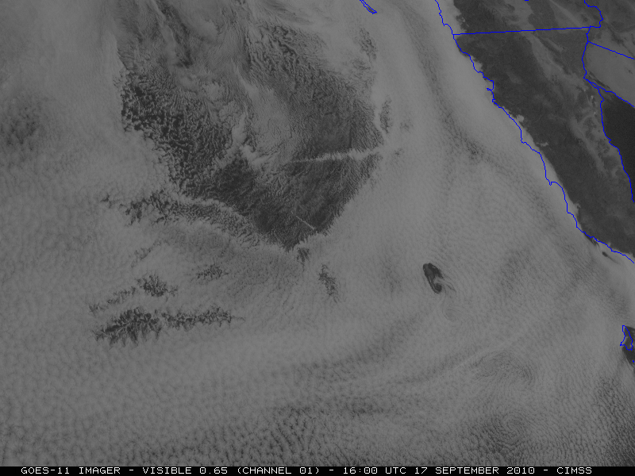
GOES-11 (US Geostationary satellite) animation of visible channel

Slide 12
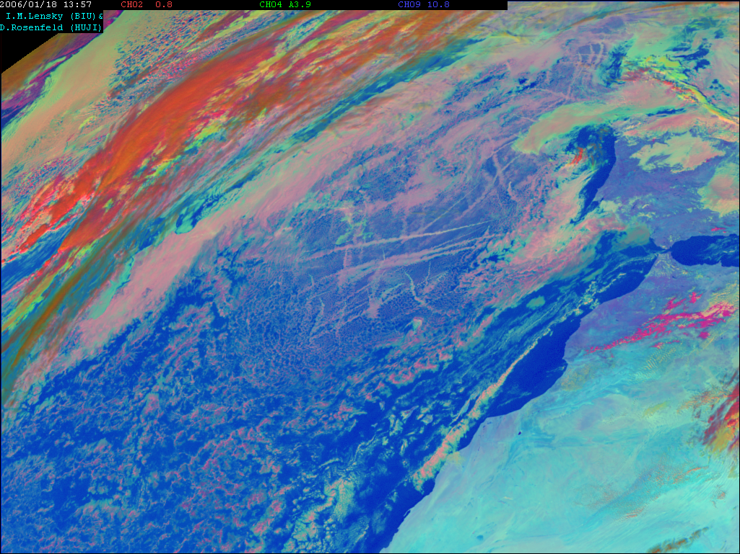
MSG Microphysical
3.7 μm 3-km
2006 01 18 13:57

Slide 13
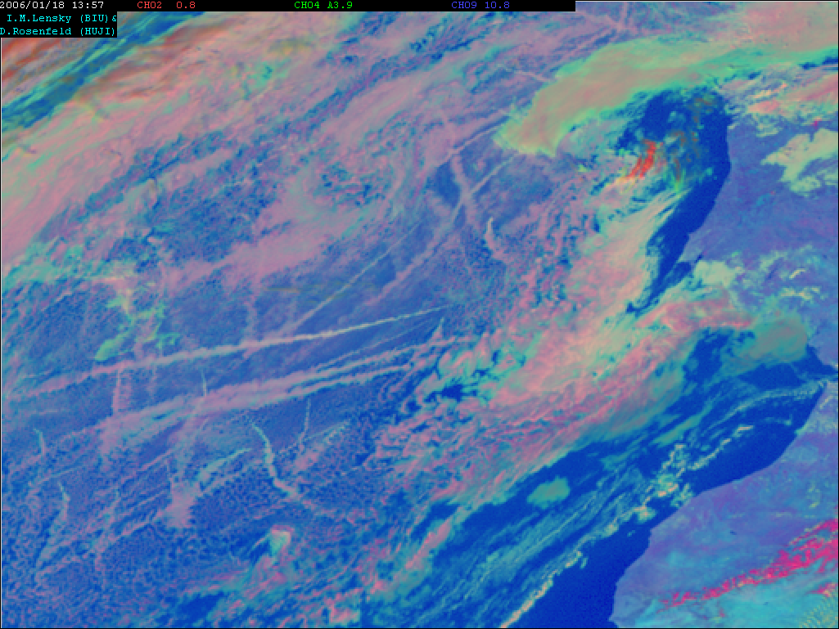
Air pollution
Ship tracks
MSG Microphysical
3.7 μm 3-km
2006 01 18 13:57

Slide 14
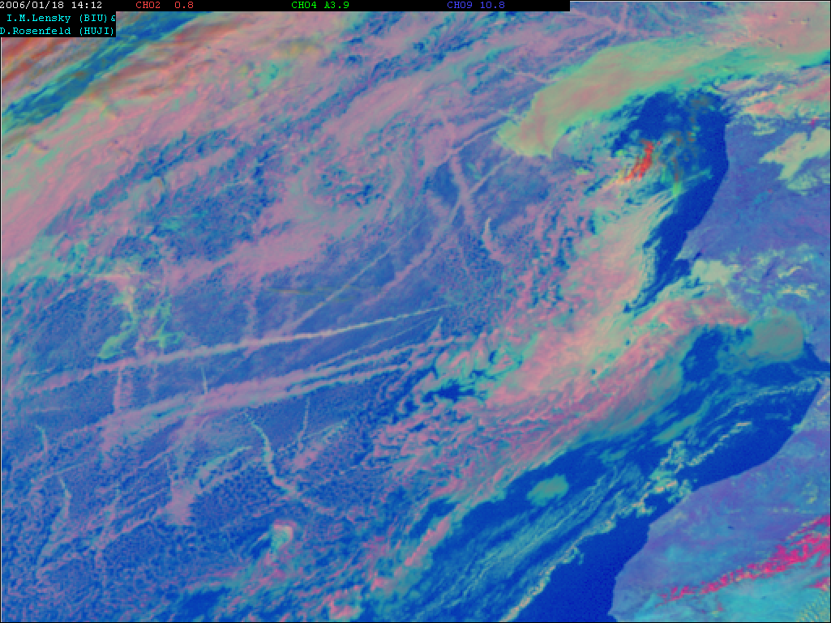
Air pollution
Ship tracks
MSG Microphysical
3.7 μm 3-km
2006 01 18 14:12

Slide 15
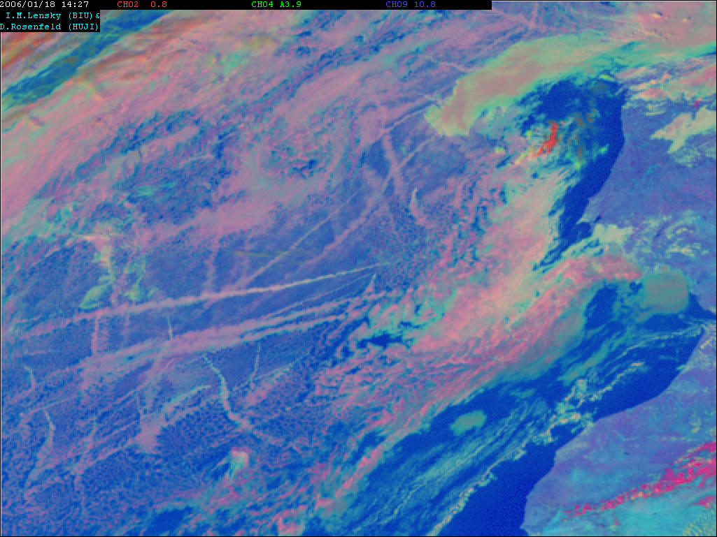
Air pollution
Ship tracks
MSG Microphysical
3.7 μm 3-km
2006 01 18 14:27

Slide 16
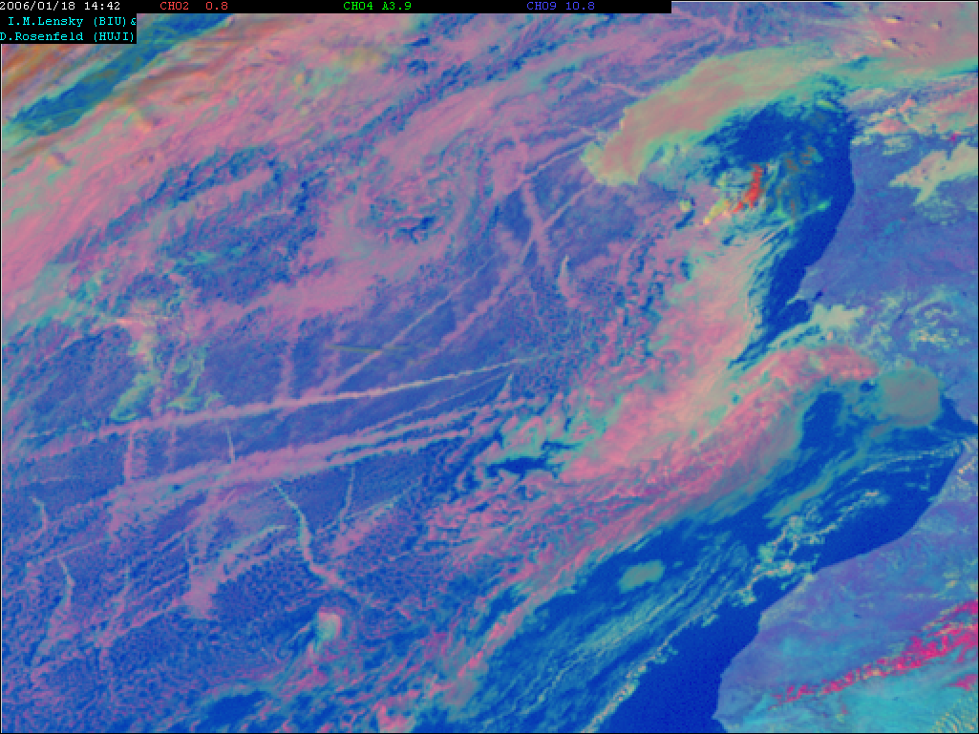
Air pollution
Ship tracks
MSG Microphysical
3.7 μm 3-km
2006 01 18 14:42

Slide 17
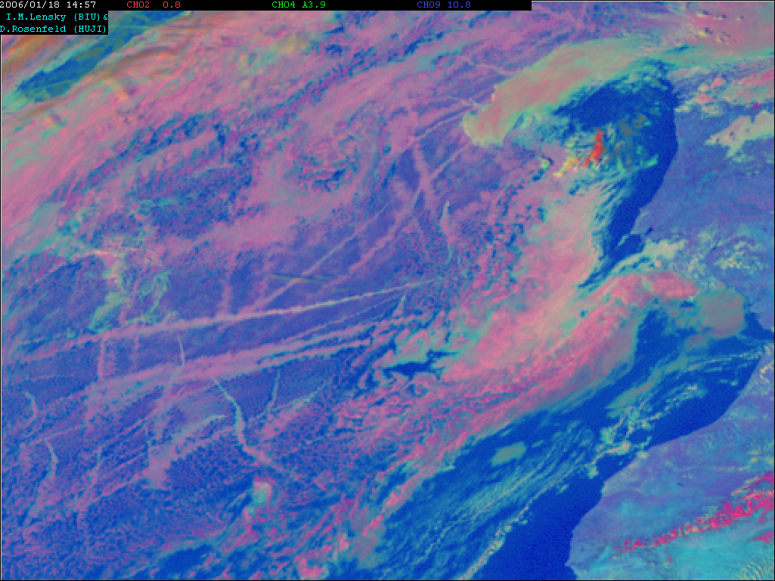
Air pollution
Ship tracks
MSG Microphysical
3.7 μm 3-km
2006 01 18 14:57

Slide 18
Animation

Slide 19
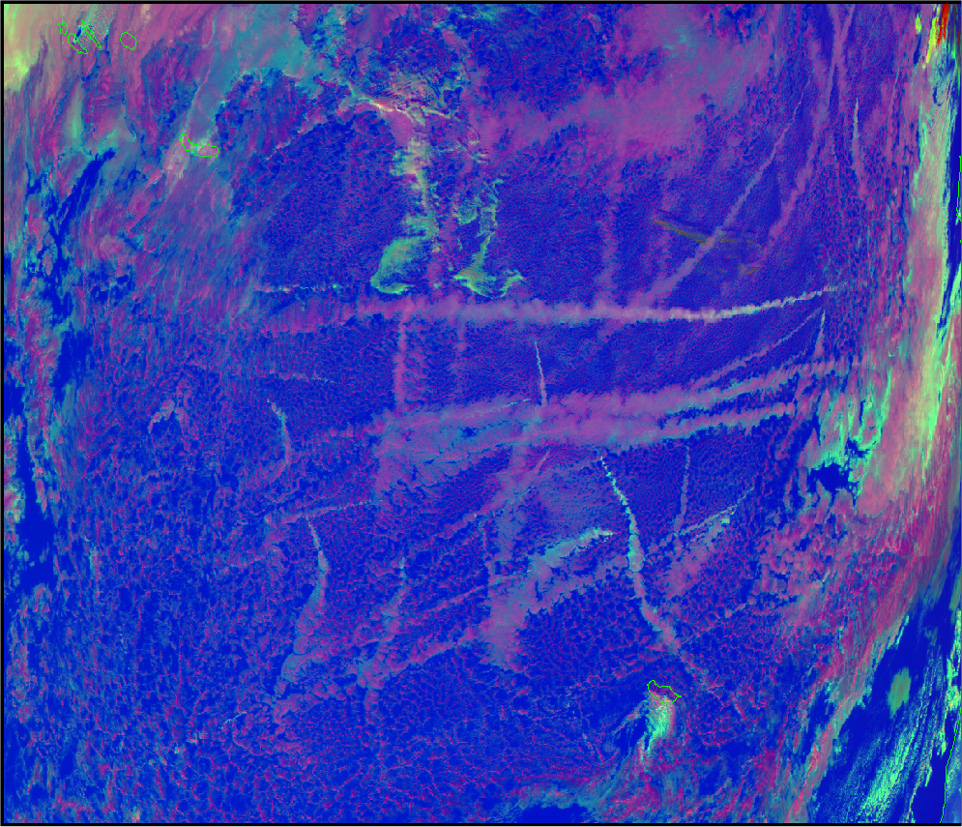
MODIS Microphysical
3.7 μm 1-km
2006 01 18 14:30
Air pollution
Ship tracks

Slide 20
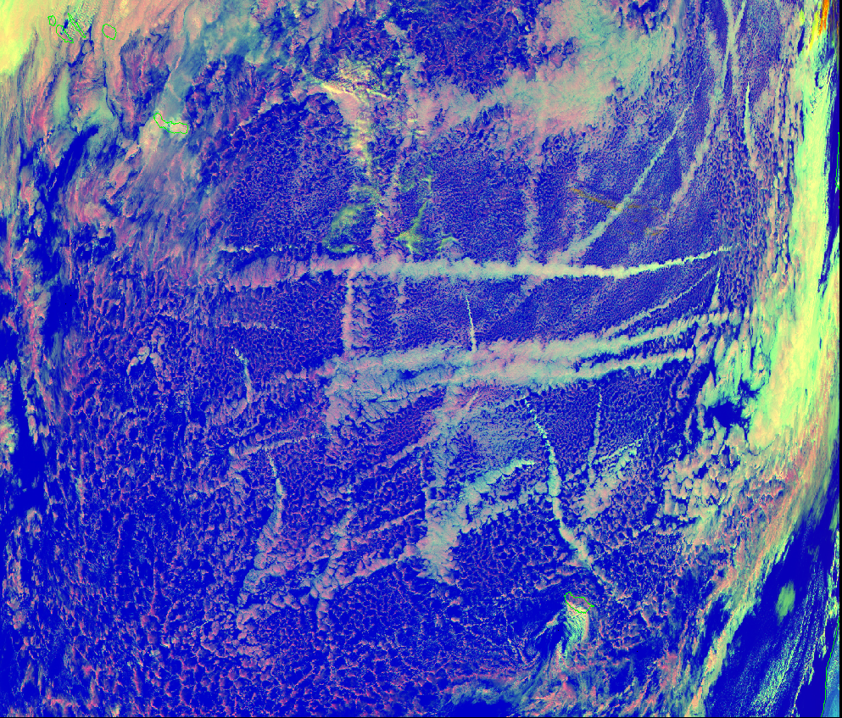
MODIS Microphysical
2.1 μm 1-km
2006 01 18 14:30
Air pollution
Ship tracks

Slide 21
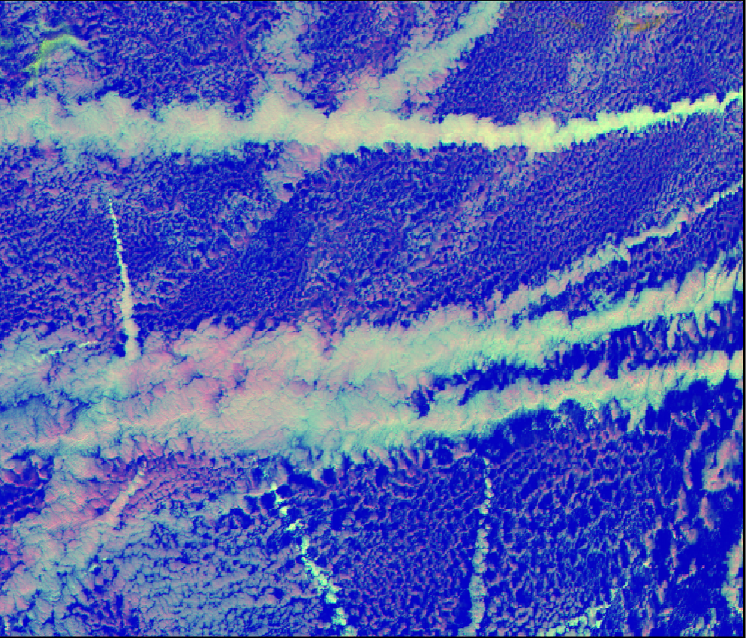
MODIS Microphysical
2.1 μm 0.5-km
2006 01 18 14:30
The small scale of the cloud elements requires the enhanced spatial resolution of the MTG 2.2 μm channel for retrieving properly cloud particle effective radius

Slide 22
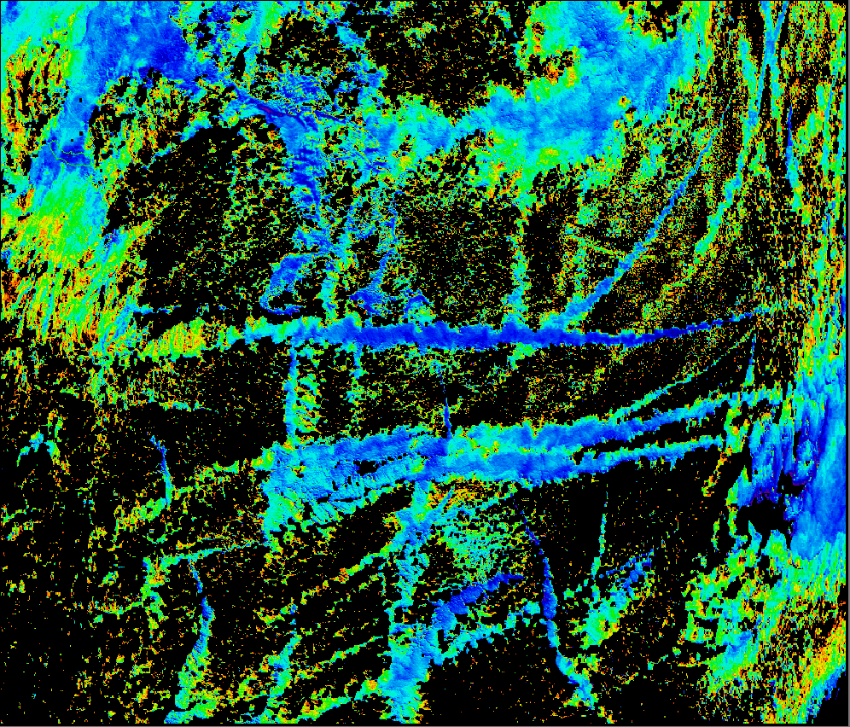
MODIS Effective radius
2.1 μm 1-km
2006 01 18 14:30
15 μm
Drizzling threshold
Effective radius [μm]
Separating precipitating from no-rain clouds

Slide 23
Ship tracks during night

Slide 24
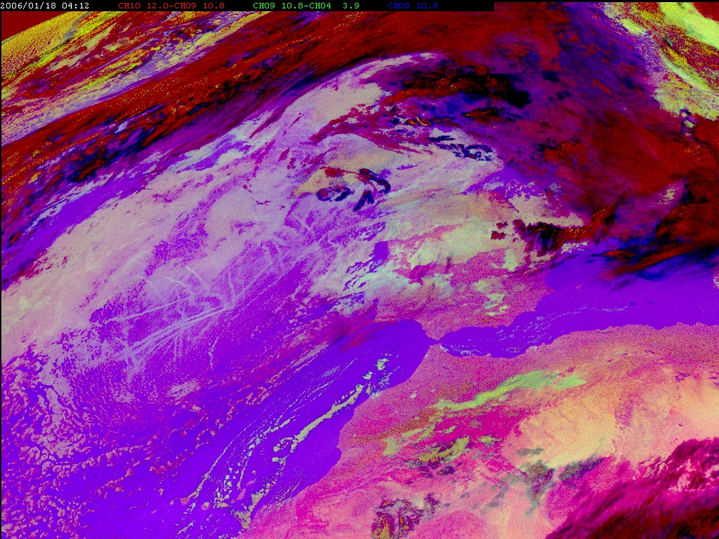
MSG Night Microphysical
10.8 - 3.9 μm 3-km
2006 01 18 04:12

Slide 25
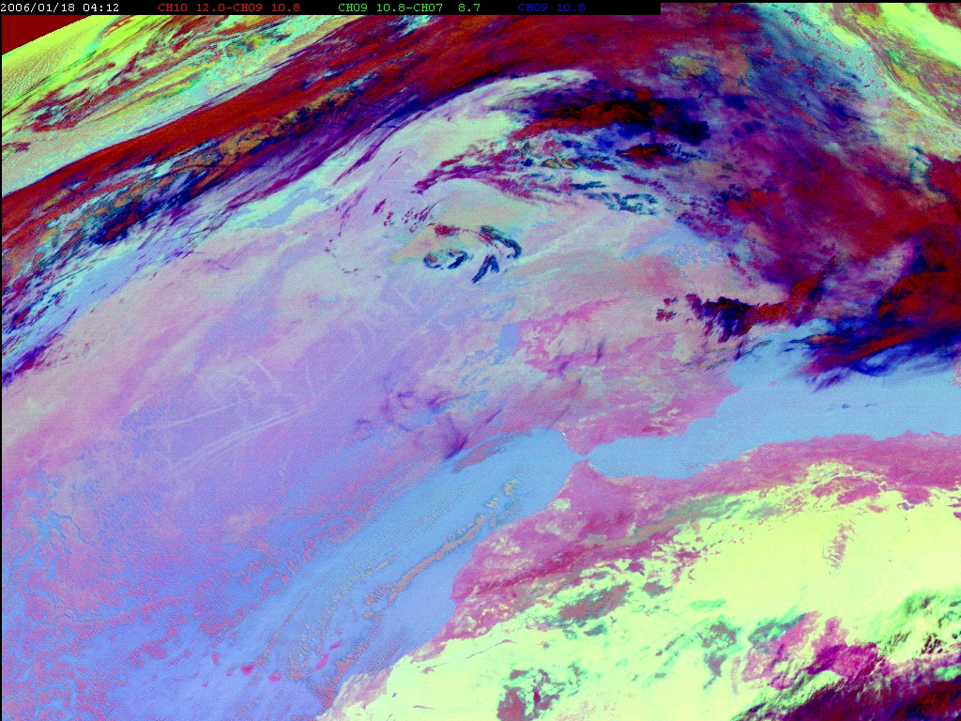
MSG 24h Microphysical
10.8 - 8.7 μm 3-km
2006 01 18 04:12

Slide 26
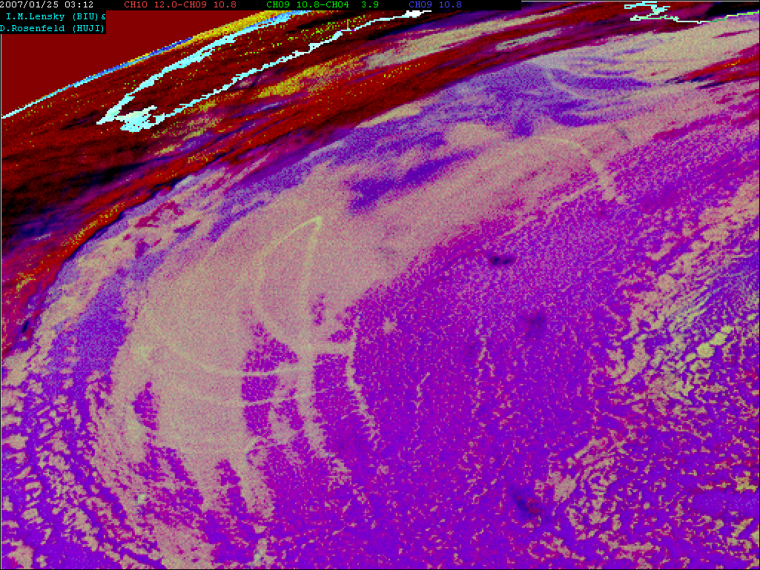
Ship tracks
Air pollution
Night Microphysical 3 km
12-10.8 10.8-3.7 10.8 μm
MSG 2007 01 25 03:12

Slide 27
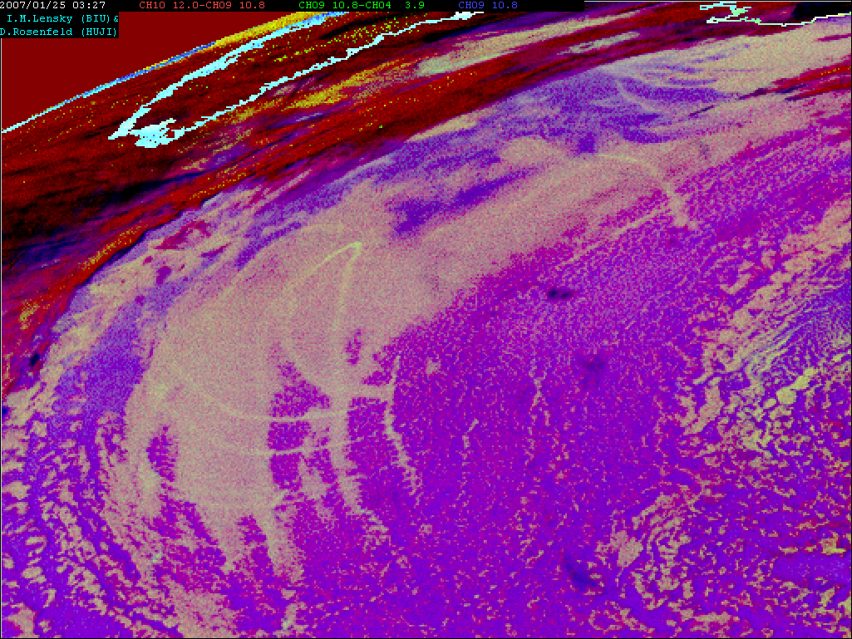
Ship tracks
Air pollution
Night Microphysical 3 km
12-10.8 10.8-3.7 10.8 μm
MSG 2007 01 25 03:27

Slide 28
Ship tracks
Air pollution
Night Microphysical 3 km
12-10.8 10.8-3.7 10.8 μm
MSG 2007 01 25 03:42

Slide 29
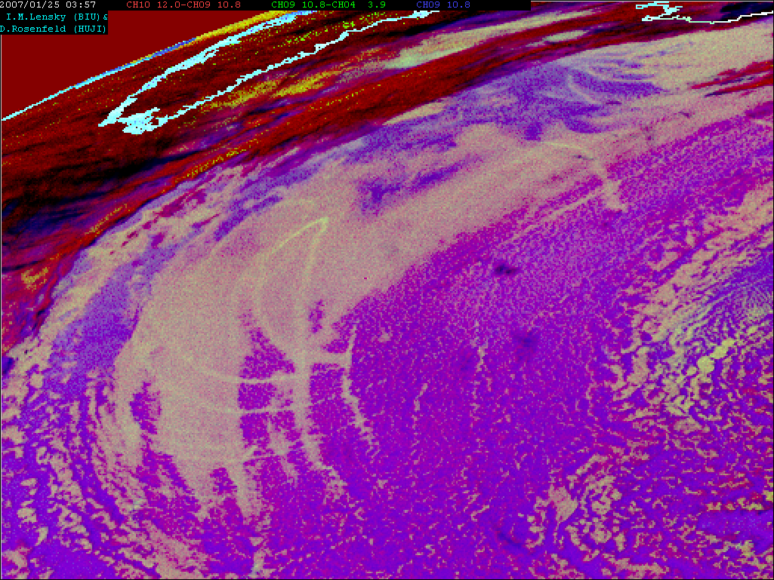
Ship tracks
Air pollution
Night Microphysical 3 km
12-10.8 10.8-3.7 10.8 μm
MSG 2007 01 25 03:57

Slide 30
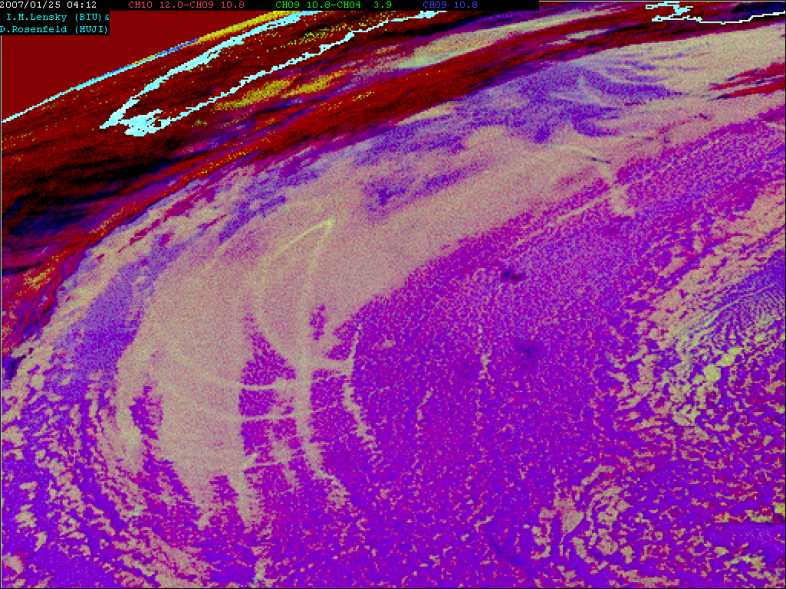
Ship tracks
Air pollution
Night Microphysical 3 km
12-10.8 10.8-3.7 10.8 μm
MSG 2007 01 25 04:12

Slide 31
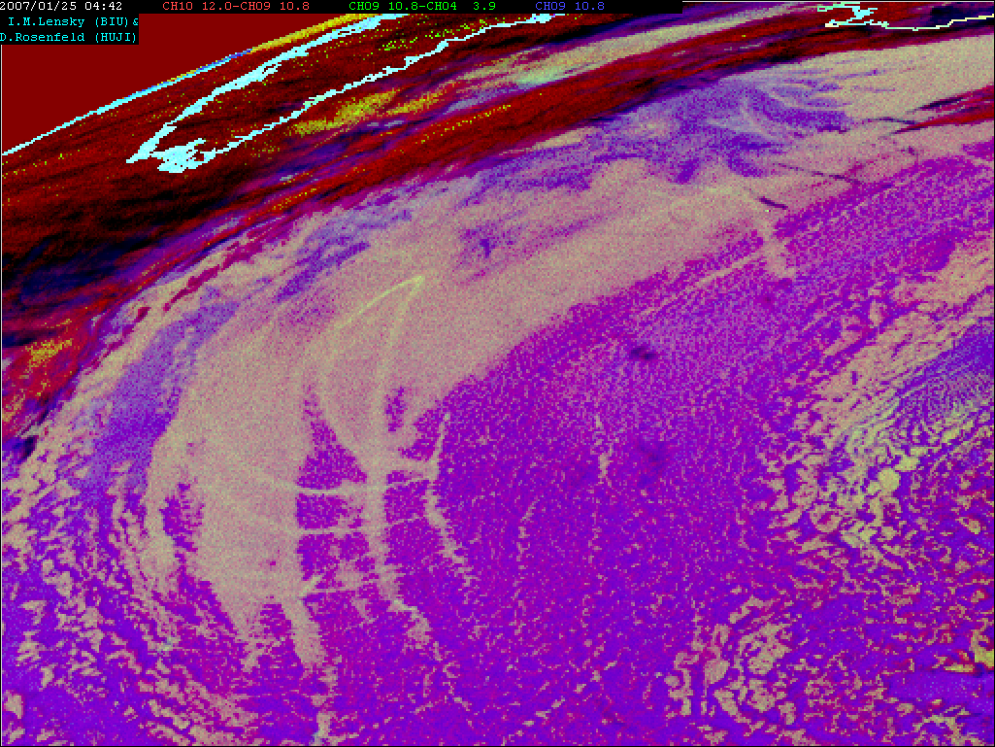
Ship tracks
Air pollution
Night Microphysical 3 km
12-10.8 10.8-3.7 10.8 μm
MSG 2007 01 25 04:42

Slide 32
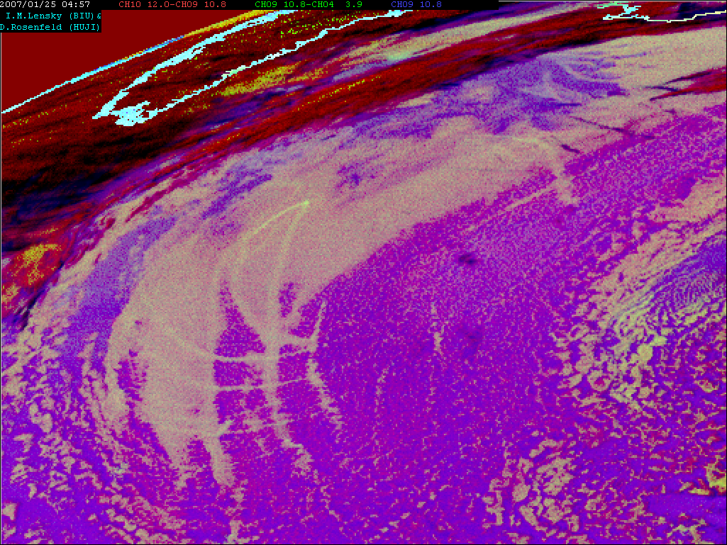
Ship tracks
Air pollution
Night Microphysical 3 km
12-10.8 10.8-3.7 10.8 μm
MSG 2007 01 25 04:57

Slide 33
Pollution tracks over land
Monitoring air quality
Identifying major pollution sources

Slide 34
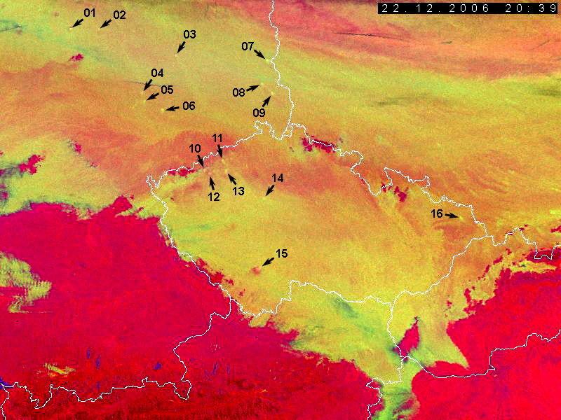
Courtesy of Martin Setvak
and Hugo Denier van der Gon
Nr | Longitude | Latitude | Probable plume origin
1 | 10.36 | 52.14 | Integrated iron and steel plant (STAHLWERKE PEINE-SALZGITTER AG - ST.W.PEINE-SALZGITTER)
2 | 10.95 | 52.16 | Brown coal-fired thermal power plant (BRAUNSCHWEIGISCHE KOHLEN-BERGWERKE - OFFLEBEN I)
3 | 12.54 | 51.87 | Not clear, nearest by: Sulphuric acid plant (GIPS-SCHWEFELSAEUREFABRIK - COSWIG) Brown coal-fired thermal power plant (VEB ENERGIEVERSORGUNG - LEIPZIG) Sulphuric acid and ammonia plant (KOMBINAT AGROCHEMIE - PIESTERITZ) Sulphuric acid plant (VEB STICKSTOFFWERKE PIESTERITZ - SALZWEDEL)
4 | 11.91 | 51.39 | Not clear, nearest by: Brown coal-fired thermal power plant (VEB ENERGIEVERSORGUNG - HALLE) Oil refinery (PETROLCHEM.KOMBINAT SCHWEDT - LUETZKENDORF)
5 | 11.98 | 51.28 | Large (petro-) chemical plant (CHEMIEKOMBINAT BUNA - LEUNA) or oil refinery (LEUNAWERKE WALTHER ULBRICHT - LEUNA)
6 | 12.37 | 51.17 | Oil-fired thermal power plant (VEB ENERGIEVERSORGUNG - LIPPENDORF)
7 | 14.47 | 51.82 | Brown coal-fired thermal power plant (GROSSKRAFTWERK - JAENSCHWALDE)
8 | 14.35 | 51.52 | Brown coal-fired thermal power plant (KRAFTWERK ARTHUR BECKER - TRATTENDORF)
9 | 14.57 | 51.41 | Brown-coal-fired thermal power plant (GROSSKAFTWERK - BOXBERG)

Slide 35
Courtesy of Martin Setvak
Czech Republic:
10 50°24’ 13°16’ Prunéřov (power plant)
11 50°31’ 13°34’ Komořany (heat plant)
12 50°23’ 13°20’ Tušimice (power plant)
13 50°25’ 13°40’ Počerady (power plant)
14 ??? ???
15 49°10’ 14°23’ Temelín (nuclear power plant)
16 49°45’ 18°19’ Ostrava – Karviná (steel industry?)

Slide 36
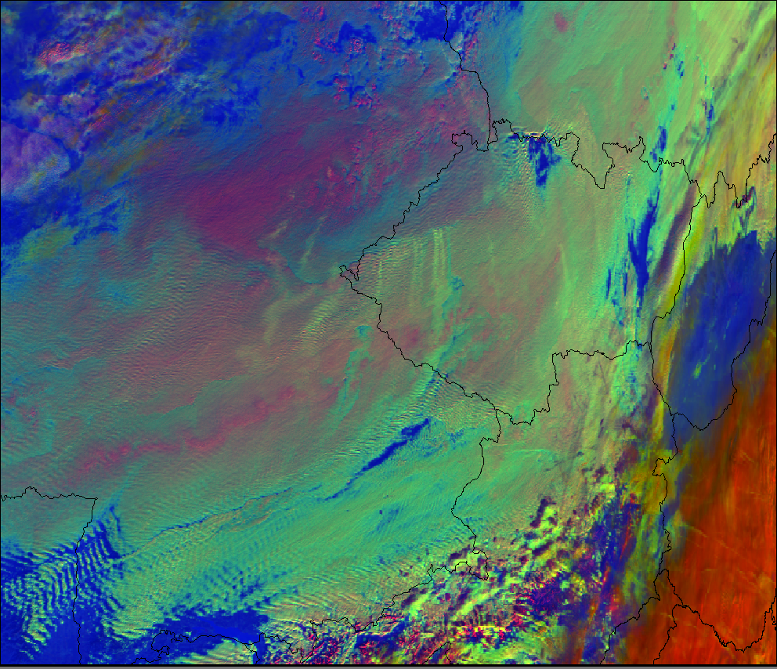
MODIS Microphysical
3.7 μm 1-km
2006 12 19 10:30
Poland
Germany
Pollution tracks from power plants

Slide 37
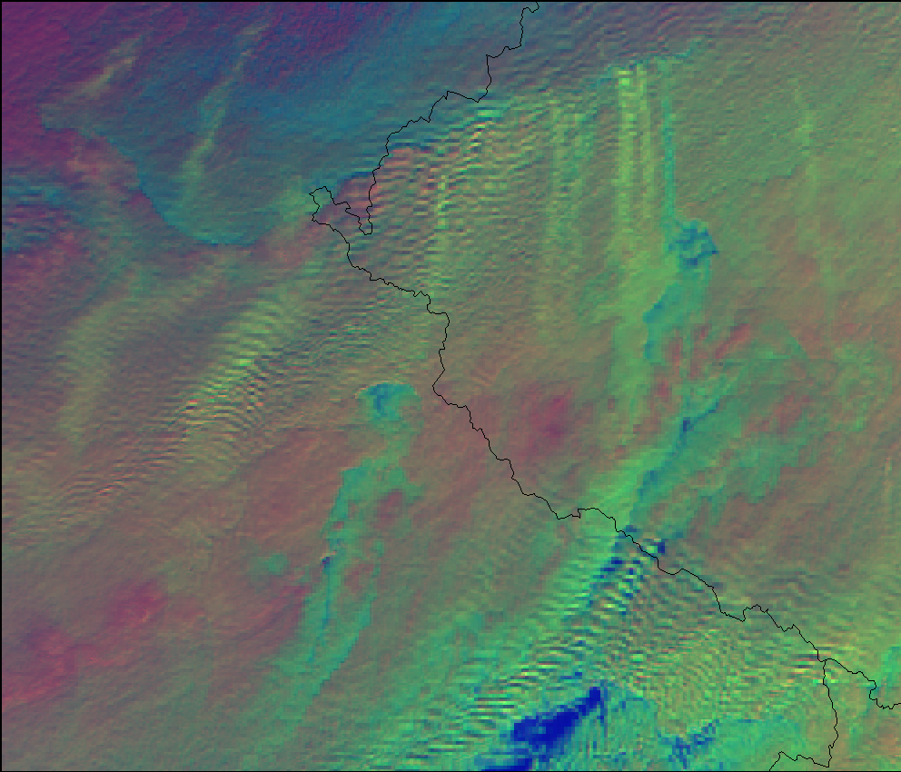
MODIS Microphysical
3.7 μm 1-km
2006 12 19 10:30

Slide 38
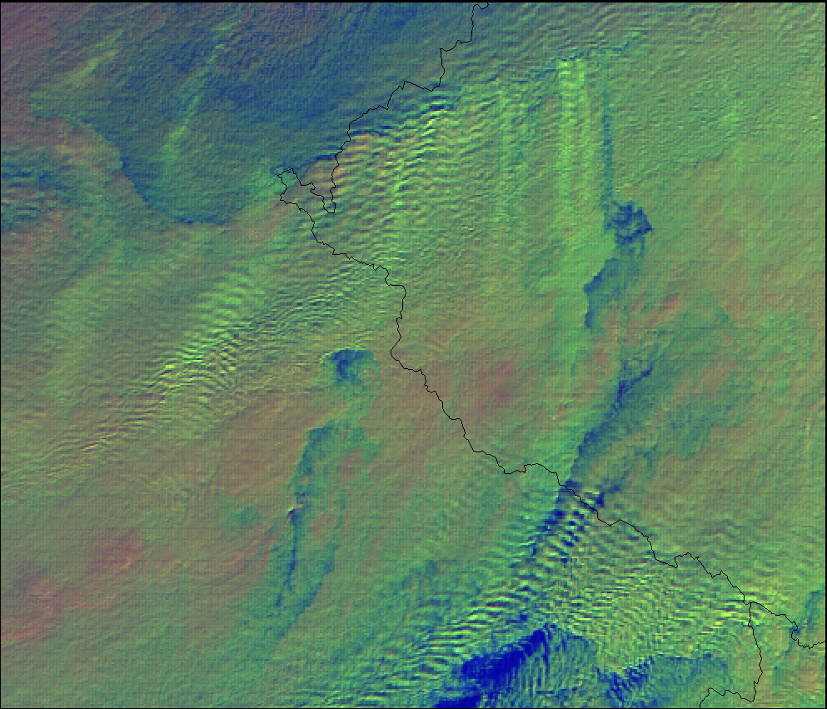
MODIS Microphysical
2.1 μm 0.5-km
2006 12 19 10:30

Slide 39
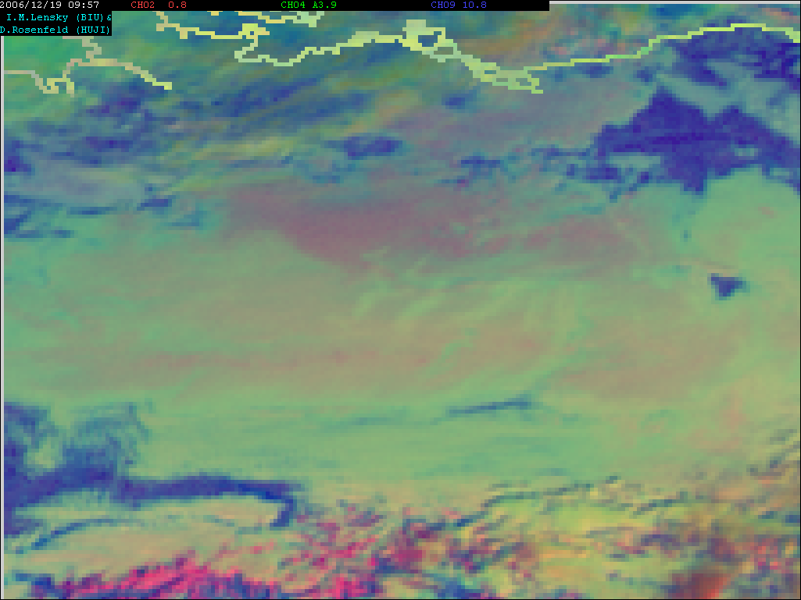
The pollution tracks are barely detectable by the MSG
Day Microphysical 3 km
0.8 3.7 10.8 μm
MSG 2006 12 19 09:57

Slide 40
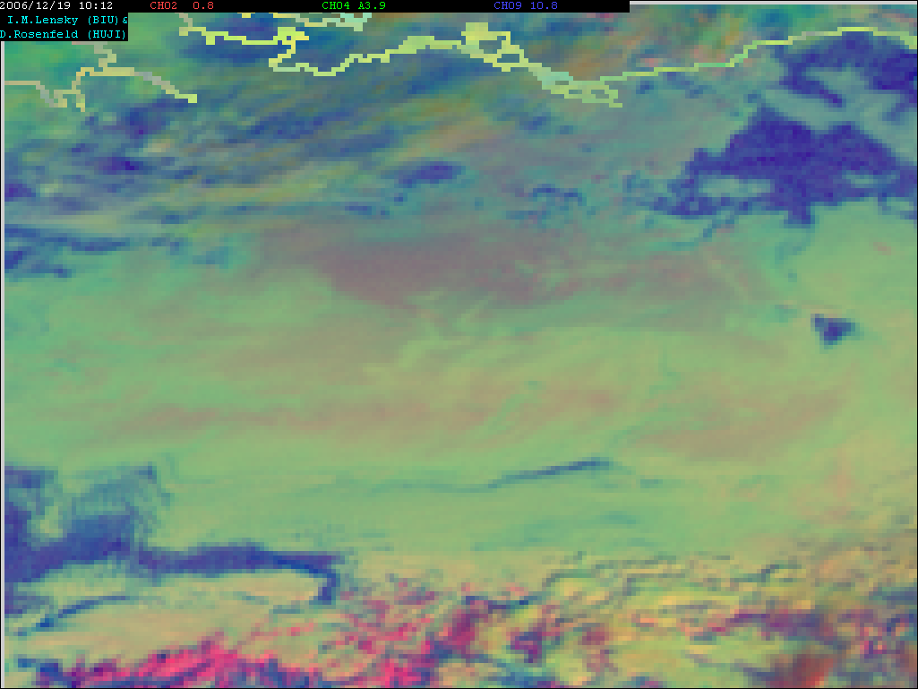
The pollution tracks are barely detectable by the MSG
Day Microphysical 3 km
0.8 3.7 10.8 μm
MSG 2006 12 19 10:12

Slide 41
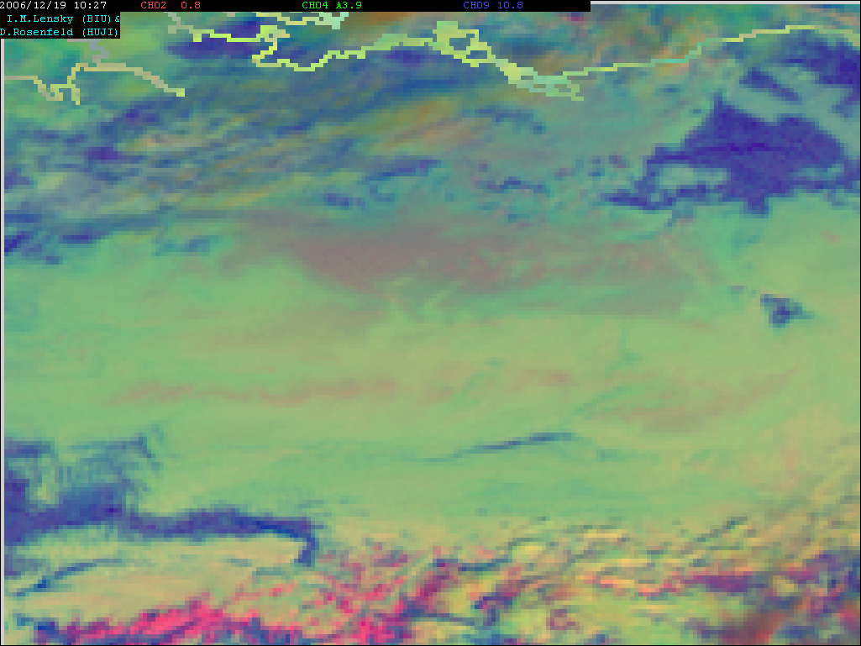
The pollution tracks are barely detectable by the MSG
Day Microphysical 3 km
0.8 3.7 10.8 μm
MSG 2006 12 19 10:27

Slide 42
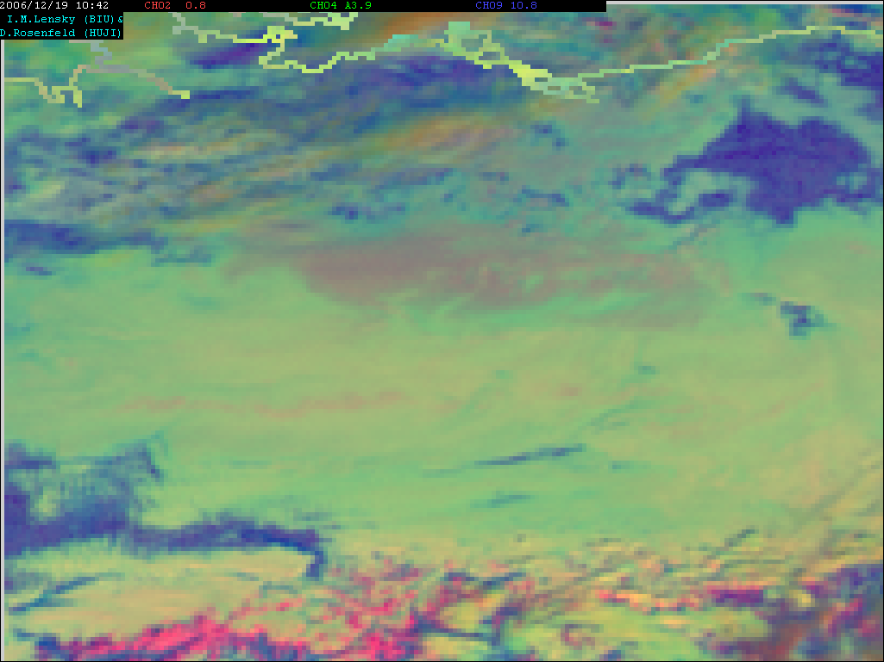
The pollution tracks are barely detectable by the MSG
Day Microphysical 3 km
0.8 3.7 10.8 μm
MSG 2006 12 19 10:42

Slide 43
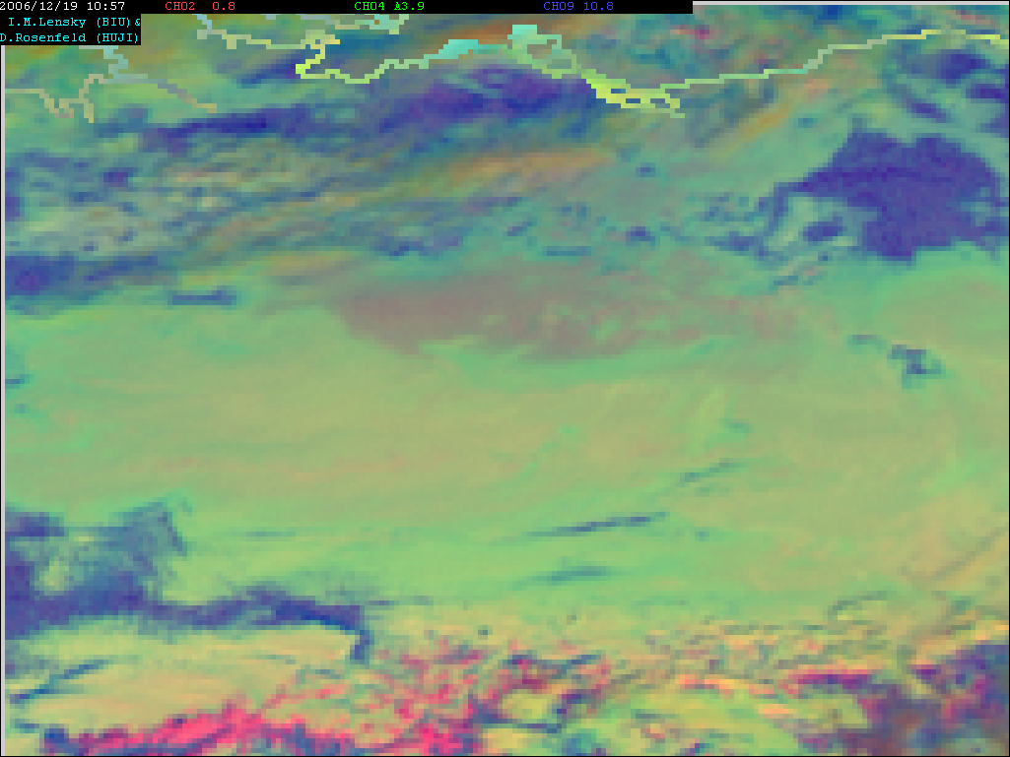
The pollution tracks are barely detectable by the MSG
Day Microphysical 3 km
0.8 3.7 10.8 μm
MSG 2006 12 19 10:57

Slide 44
Case 2

Slide 45
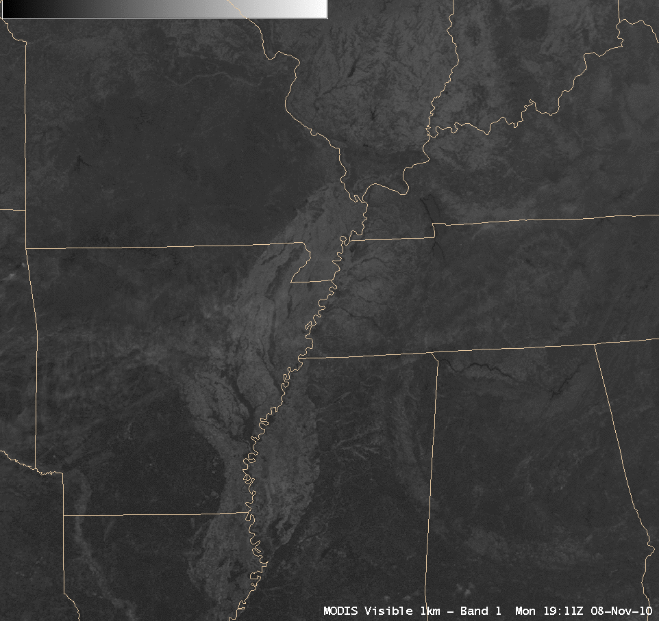
Direct Broadcast captured MODIS data

Slide 46
Contrails
Contrails ( short for "condensation trails") are long thin clouds that sometimes form behind jet aircraft. Contrails form when hot, humid air from jet exhaust mixes with environmental air of low vapor pressure and low temperature. The mixing is a result of turbulence generated by the engine exhaust. Cloud formation by a mixing process is similar to the cloud you see when you exhale in cold air and “see your breath.”
At high altitudes the warm, moist exhaust emerges into a cold environment, and the local increase in water vapour can raise the relative humidity of the air past saturation point, condensing to form tiny water droplets which fan then freeze.

Slide 47
Detection
The optical properties of contrails are strong functions of their optical depth, effective radius, and ice crystal habit, as well as the background radiation fields, which are parameters that vary with time. The optical depths of contrails measured from passive satellite imagers are typically between 0.1 and 0.5 (Minnis et al. 2005), but they can be much smaller, and values larger than 1 are not uncommon.
Contrails are visible for at 1.38 microns or in a display of the brightness temperature difference between channels 11 and 12 micron. But, also, cloud edges and surface features appear as bright lines.

Slide 48
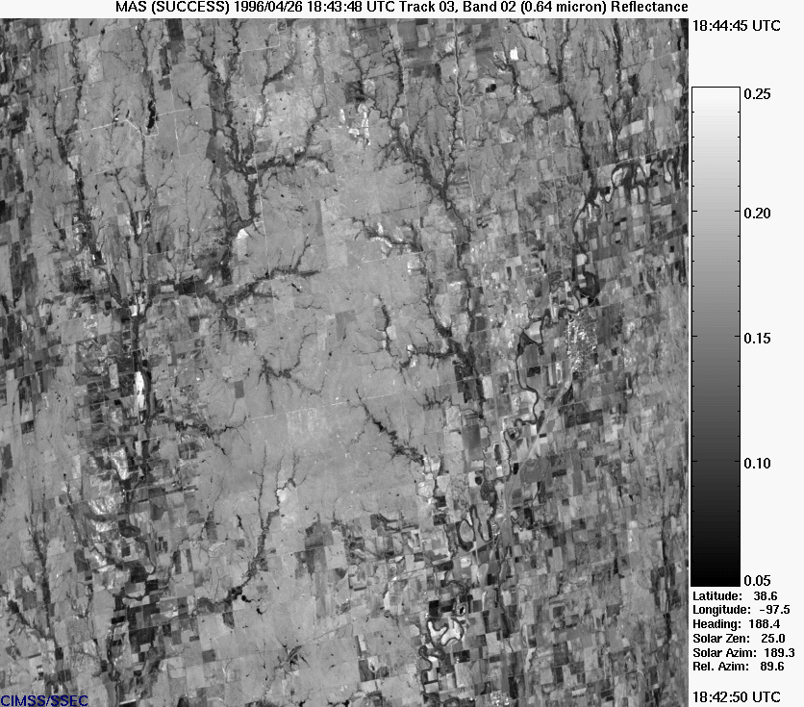
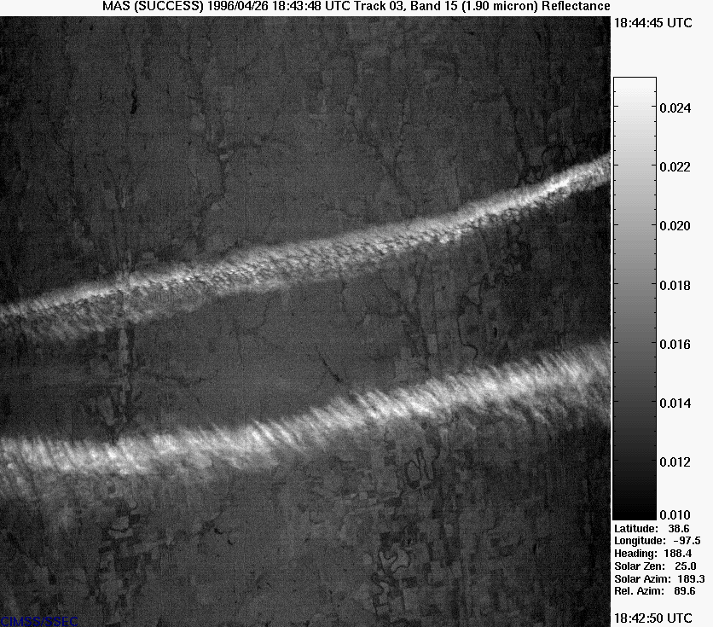
MTG Improvements: detection of thin ice clouds
VIS0.6 image: thin cirrus is practically not detectable
(IR: thin cirrus too semitransparent)
NIR1.3 image: water vapour absorption within lower atmosphere is strong, so that Ci is well detectable behind a “dark” background
courtesy J. Purdom, CIRA
Application: Better cloud detection in support to other products, climate impact of contrails, ...

Slide 49
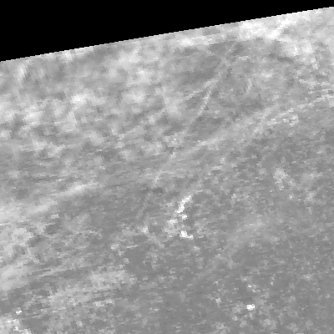
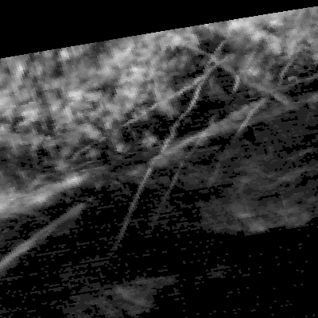
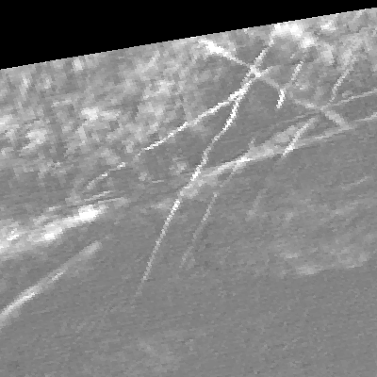
MTG Improvements: detection of thin ice clouds
8 Nov 2010, 19:10 UTC, MODIS
VIS0.6 image: thin cirrus is practically not detectable
NIR1.3 image: water vapour absorption within lower atmosphere is strong, so that Ci is well detectable behind a “dark” background
Difference IR11-IR12: thin cirrus is also detectable
Application: Better cloud detection in support to other products, climate impact of contrails, ...

Slide 50
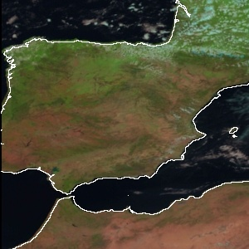
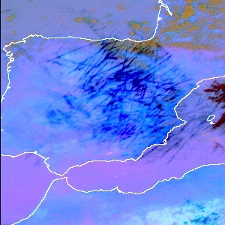
NIR1.3: Another Example
SEVIRI, Nat. Colour RGB
MODIS, NIR1.3 image, 23 May 2005, 11:00 UTC
SEVIRI, Dust RGB
courtesy D. Rosenfeld, Univ. Jerusalem

Slide 51
Animation

Slide 52
Case 3

Slide 53
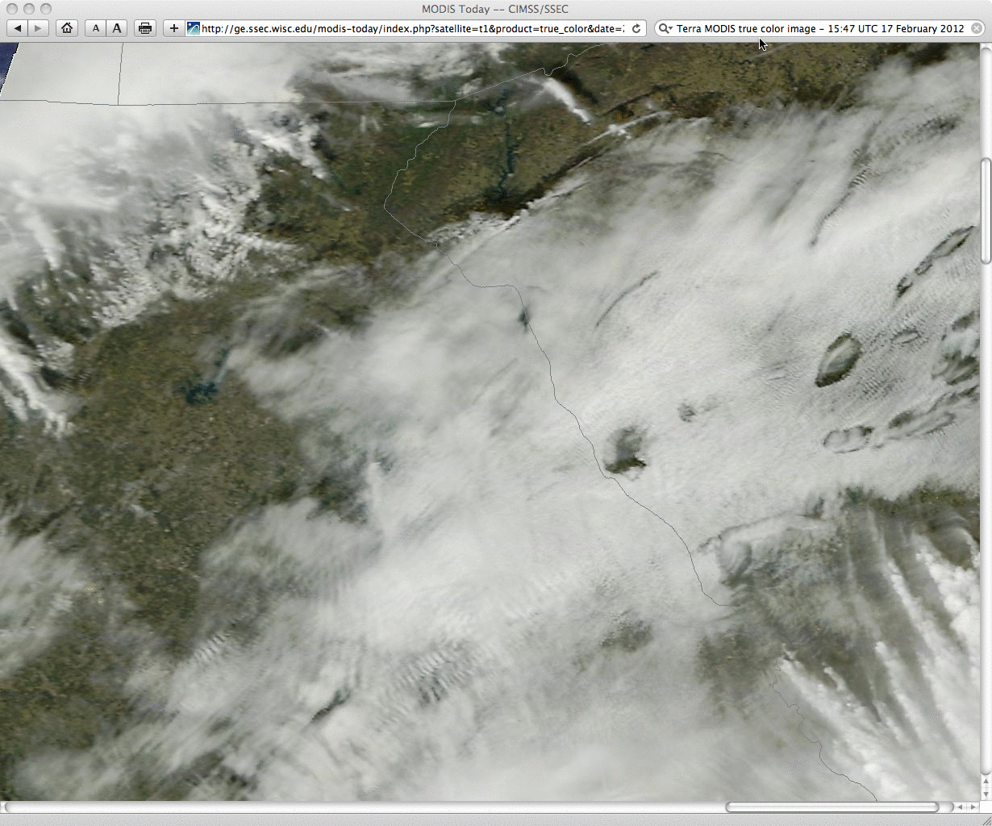
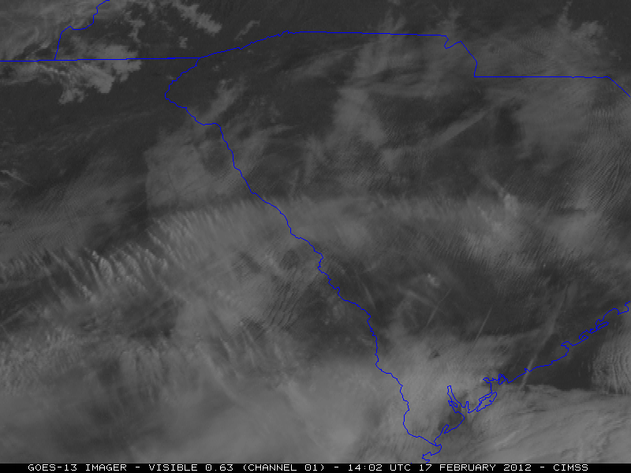
Full spatial resolution MODIS data

Slide 54
GOES-13 (US Geostationary satellite) animation

Slide 55
Distrails
Distrail is short for "dissipation trail". Where an aircraft passes through a cloud, it can clear a path through it; this is known as a distrail. These are super cooled clouds and the aircraft causes the cloud to glaciate and the large ice crystals fall out of the cloud.

Slide 56
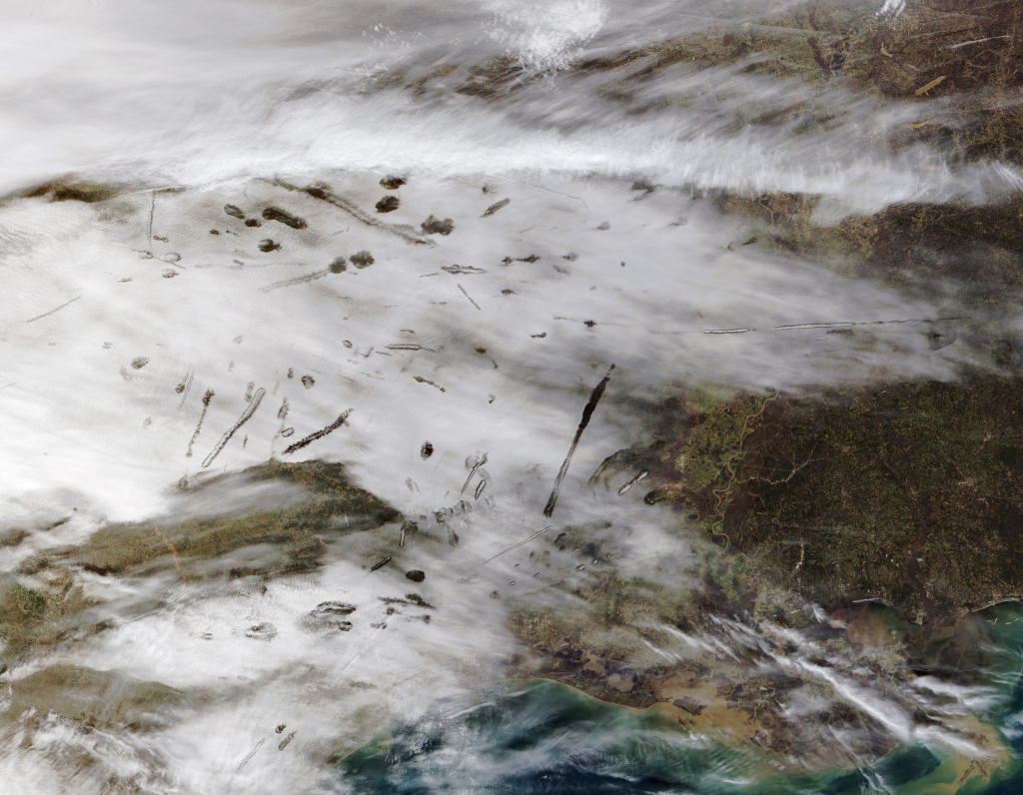
Case: 29 Jan 2007, Texas

Slide 57
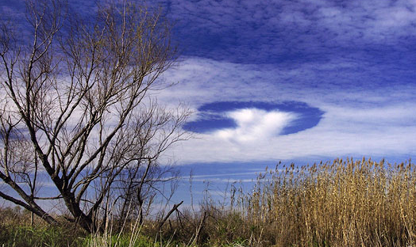
Pictures of distrails from ground

Slide 58
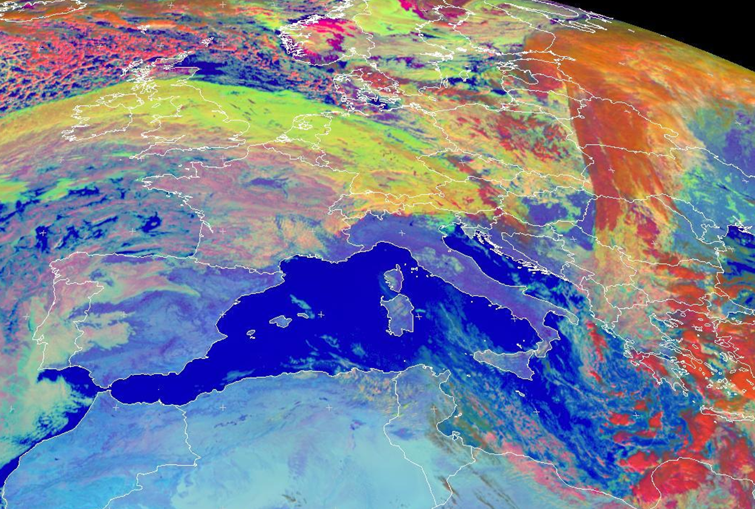
Comment on where ice clouds are located and where water clouds are located
Case: 6 Nov 2013, Europe

Slide 59
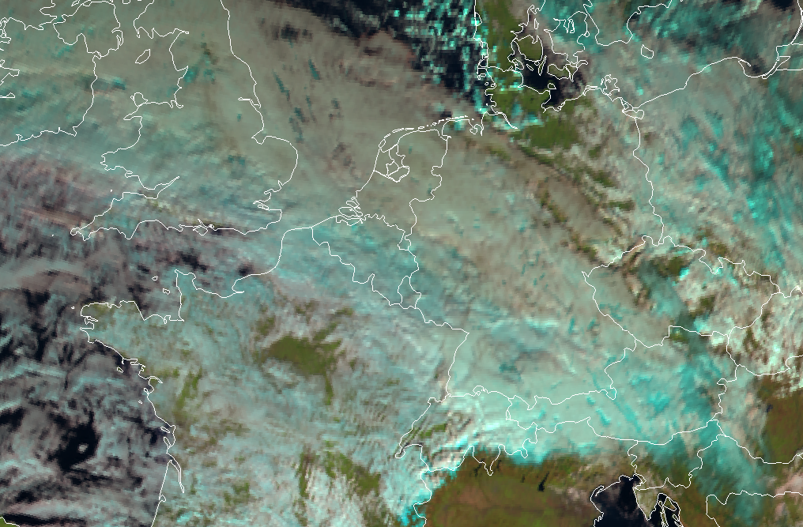
Comment on where ice clouds are located and where water clouds are located
Ice clouds
Ice clouds
Water clouds
?
Water clouds
above snow
Water clouds

Slide 60
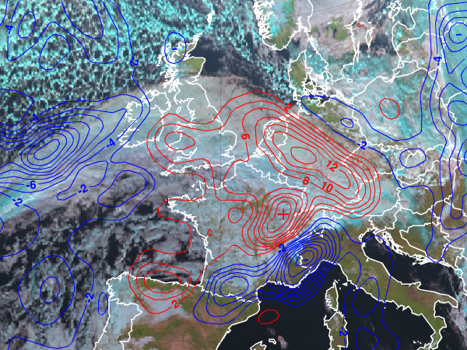
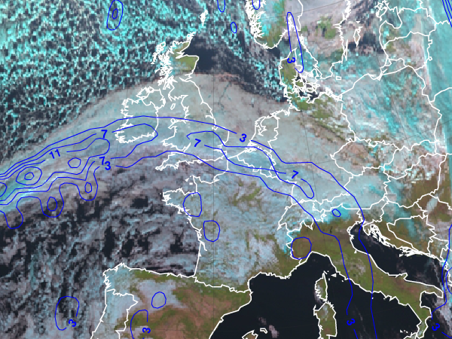
Analyze the cloud system over UK, the North Sea and Germany in terms of conceptual models
TA 700 hPa TFP
ePort
Analyze the following ECMWF NWP parameters: temperature advection at 700 hPa (TA700), Thermal Front Parameter (TFP), 1000 hPa divergence field (DIV1000)

Slide 61
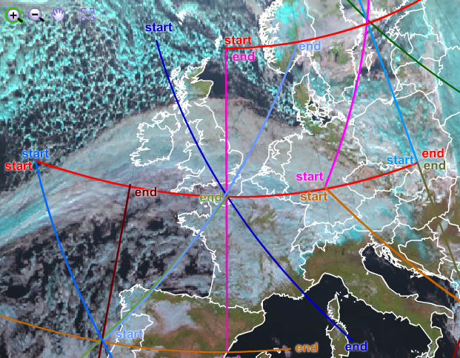
Analyze a vertical cross section

Slide 62
Precipitating Clouds product (NWC SAF)

Slide 63
6 Nov 2013, 12:00 UTC (source: EUMeTrain ePort)
Day Microphysics RGB
Supercooled cloud
(warm front – strong upper level NW winds)
BT IR10.8 around -30 to -33 deg C !!

Slide 64
6 Nov 2013, 12:00 UTC (source: EUMeTrain ePort)
Cloud Top Height Product
Cloud is at 7-8 km height !!

Slide 65
Zoom of previous RGB image
With 300 hPa absolute topography
Multi-layer (2 layers) cloud:
Lower warm water cloud at about 1 km
Upper supercooled cloud at 7-8 km
below
6 Nov 2013, 12:00 UTC (source: EUMeTrain ePort)

Slide 66
6 Nov 2013 , Metop AVHRR
Day Natural Colours RGB
Distrails (ice clouds)

Slide 67
6 Nov 2013, 11:00 UTC , NPP VIIRS
Day Natural Colours RGB (from HP Roesli)
Distrails (ice clouds)

Slide 68
Which RGB product shows these holes with the best contrast?
RGB Day Natural Colour
RGB Day Microphysics
RGB Dust (24h Microphysics)
RGB Convection

Slide 69
6 Nov 2013, 13:00 UTC , MSG (Met-10)
Convection RGB
Distrails

Slide 70
6 Nov 2013, 13:00 UTC , MSG (Met-10)
Day Natural Colours RGB
MSG Natural Colours RGB not so good to show cloud phase
Distrails

Slide 71
6 Nov 2013, 13:00 UTC , MSG (Met-10)
24-h Microphysics RGB
Distrails

Slide 72
Which RGB product shows these holes with the best contrast?
RGB Natural Colours RGB Convection
(best contrast)

Slide 73
Ice clouds (NDSI of -0.3 to -0.4)
AVHRR NDSI (range from -1 to +1)
NIR1.6-VIS0.6 / NIR1.6+VIS0.6

Slide 74
Cloud top height cloud phase
Cloud droplet effective radius precipitation rate
KNMI Cloud Products

Slide 75
6 Nov 2013, 12:39 UTC , NPP VIIRS
Day Natural Colour RGB (from Tom Goren, HUJ)
Punch Holes
(Distrails)

Slide 76
6 Nov 2013, 12:39 UTC , NPP VIIRS
Day Microphysics RGB (from Tom Goren, HUJ)
Punch Holes
(Distrails)

Slide 77
6 Nov 2013, 12:39 UTC , NPP VIIRS
Day Natural Colour RGB (from Tom Goren, HUJ)
Punch Holes
(Distrails)

Slide 78
6 Nov 2013, 12:39 UTC , NPP VIIRS
Day Microphysics RGB (from Tom Goren, HUJ)
Punch Holes
(Distrails)

Slide 79
6 Nov 2013, 13:00 UTC , MSG (Met-10)
HRV Channel
Distrails

